Slide 2
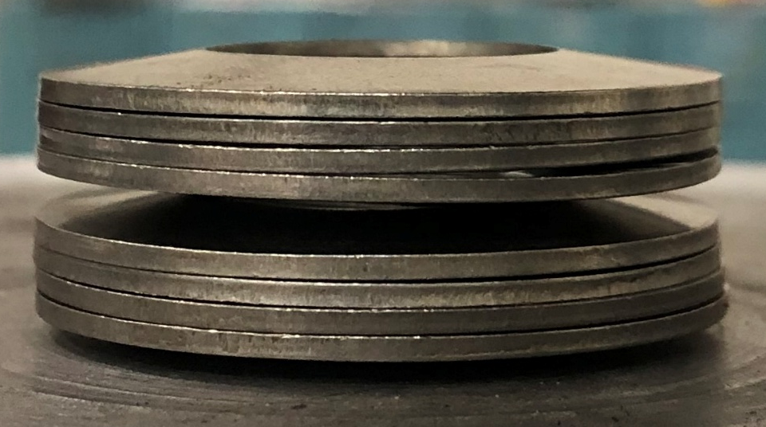

Slide 3
No. | Units |  | Stack
 | Configuration | Naming
1 |  | 1U
2 |  | 1D
3 |  | 1U1D
4 |  | 2U2D | Example: Stack consisting of 2 units of 2U2D
5 |  | 3U3D

Slide 4
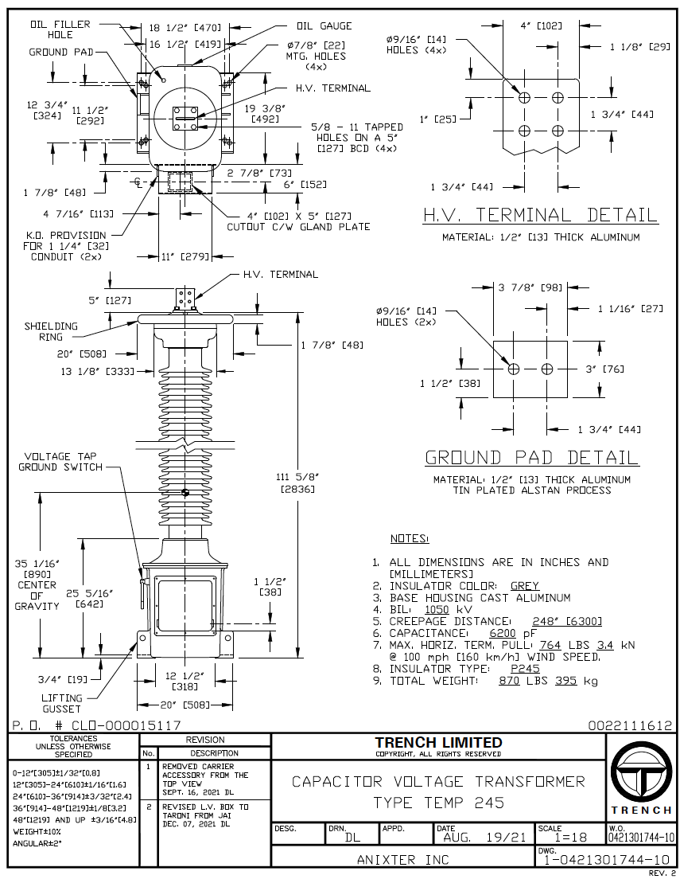

Slide 5
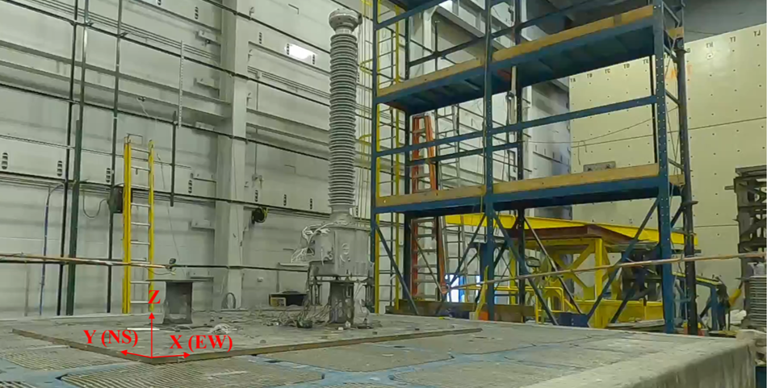
CVT
Belleville washers
Spool
Shake table

Slide 6
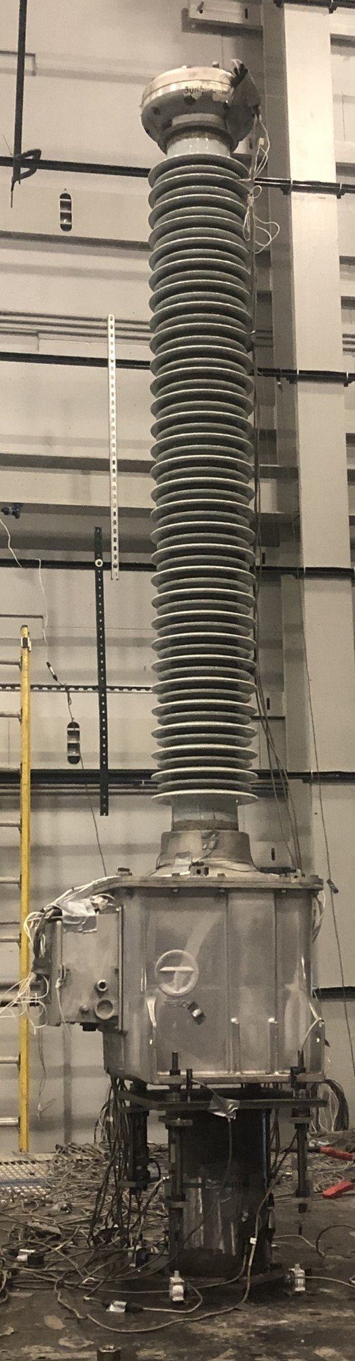
Top acceleration
and displacement, X and Y
Mid acceleration, X and Y
Strains at Bushing base
N, S, E and W
CVT box acceleration, Z
in N, S, E and W
Z
Y
X

Slide 7
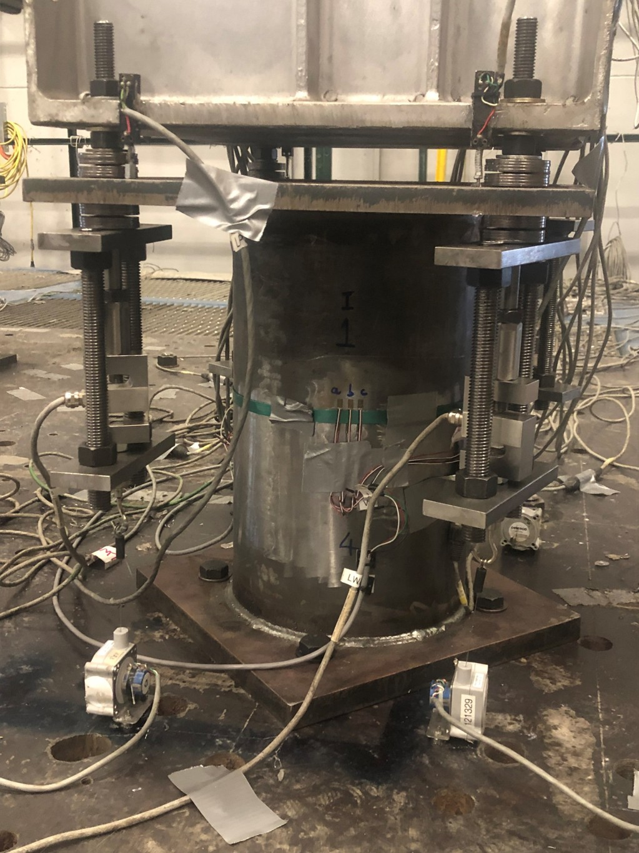
Top stack deformation
4 LWAs, each corner
Moment, X and Y
Z
Spool
Y
X

Slide 8
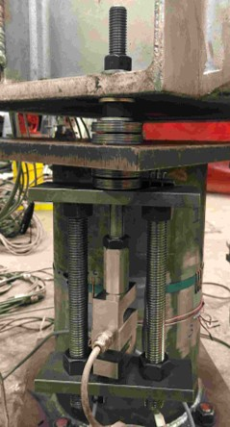
Z
Nut used to apply preload
Y (NS)
Spool top plate
X (EW)
K1875 2 units of 2U2D
Spool
3/4in rods to complete load path
Load cell

Slide 9
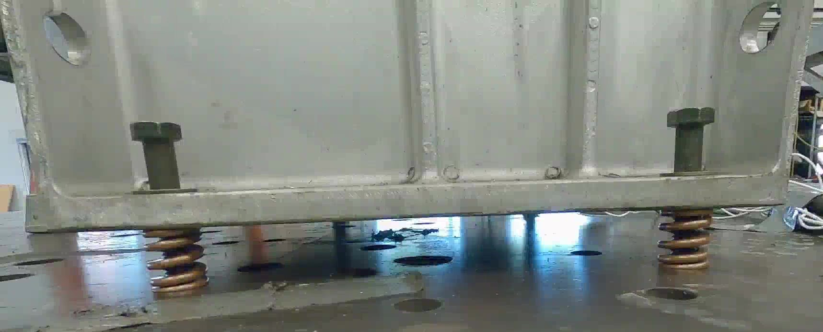
CVT base
Guide bolt
2,120 lb/in springs
at four corners
Floor

Slide 10
CVT base
Guide bolt
2,120 lb/in springs
at four corners
Floor

Slide 11
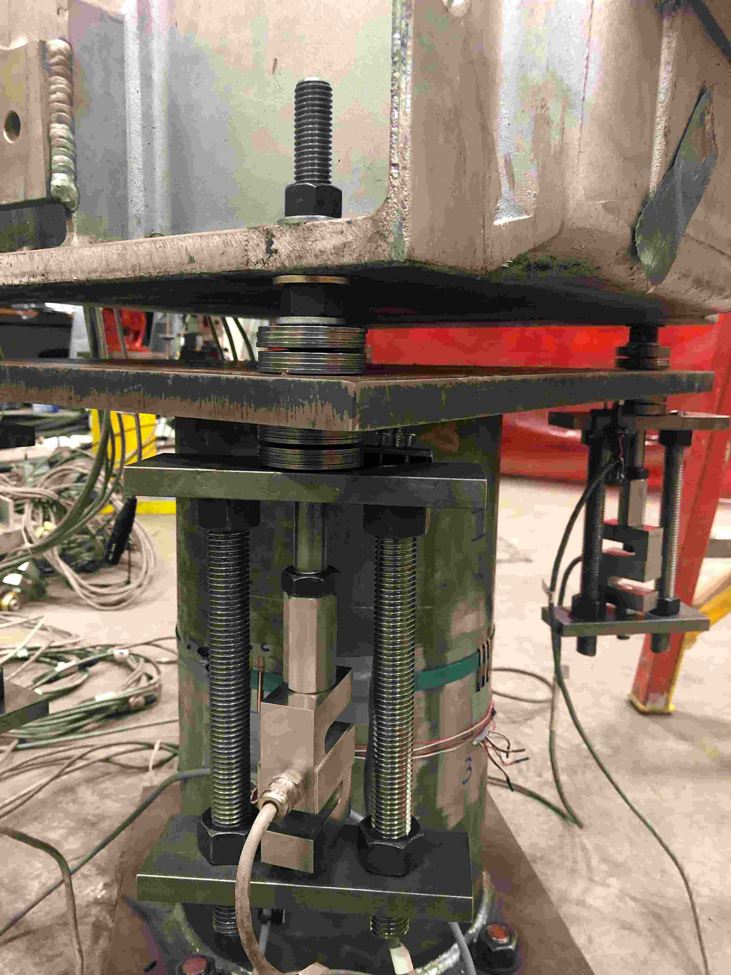
Z
Nut used to apply preload
Y (NS)
Spool top plate
X (EW)
K1875 2 units of 2U2D
Spool
3/4in rods to complete load path
Load cell

Slide 12
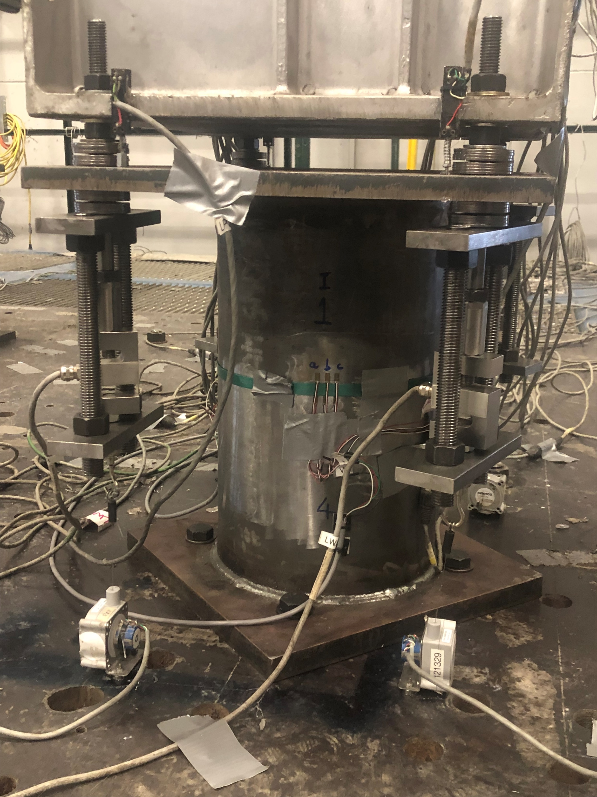
Top stack deformation
4 LWAs, each corner
Moment, X and Y
Z
Spool
Y
X

Slide 13

Top acceleration
and displacement, X and Y
Mid acceleration, X and Y
Strains at Bushing base
N, S, E and W
CVT box acceleration, Z
in N, S, E and W
Z
Y
X

Slide 14
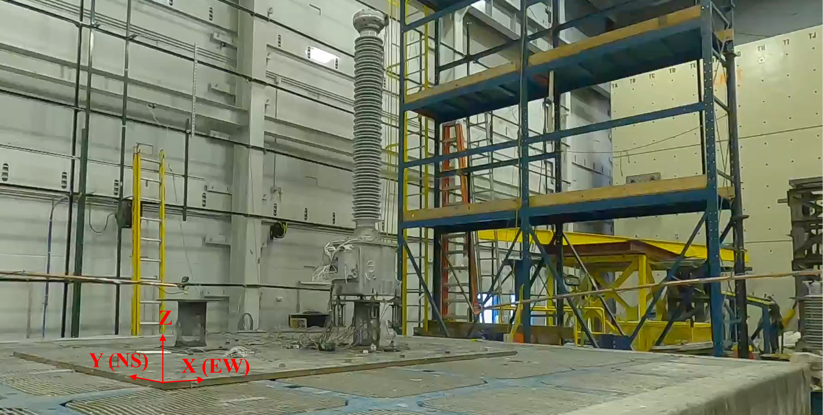
CVT
Belleville washers
Spool
Shake table

Slide 22
